Slide 1


Virtual Internship 7.0 Cyber Threat Analytics Platform with Incident Visualization System Group -1 Presented By: Vennela Pathipaka Internship/Organization: INFOSYS SPRINGBOARD VIRTUAL INTERNSHIP 7.0 Team : D Mentor : Ms. S J Nityasree

Slide 2
Project Objective:
Analyze Incident Data Use Microsoft Power BI to analyze cybersecurity incidents and identify meaningful patterns.
Identify Attack Patterns Analyze attack types, threat actors, attacker motives, and incident trends.
Monitor Global Threats Visualize the geographical distribution of cybersecurity incidents and identify major threat areas.
Drive Security Insights Convert cybersecurity incident data into interactive dashboards and meaningful insights for better analysis.

Slide 3





Project Description:
Data Understanding Understand the cybersecurity incident dataset, its structure, attributes, and relevant fields.
Data Preprocessing Clean the dataset by handling missing values, duplicates, inconsistent entries, and unnecessary data.
Data Modeling Organize the cleaned data and create calculated measures using DAX for effective analysis.
Cybersecurity Visualization Develop interactive Power BI dashboards to analyze cyber incidents, attack patterns, threat actors, and trends.

Slide 4
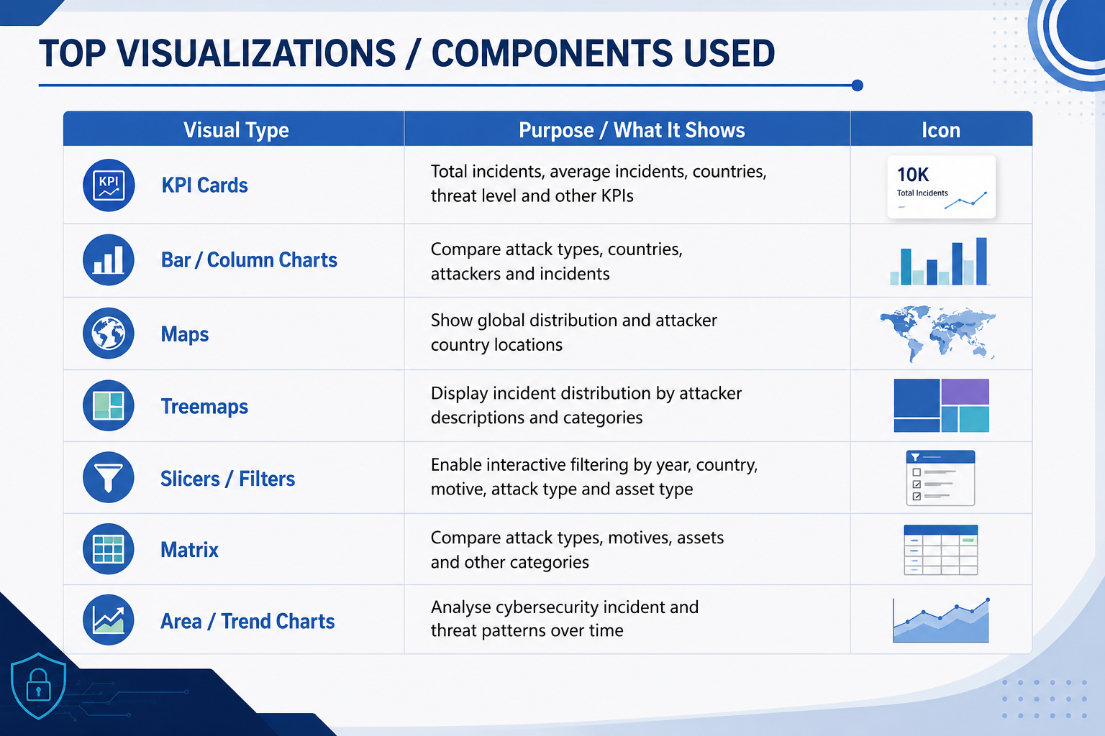
Top Visualization:

Slide 5
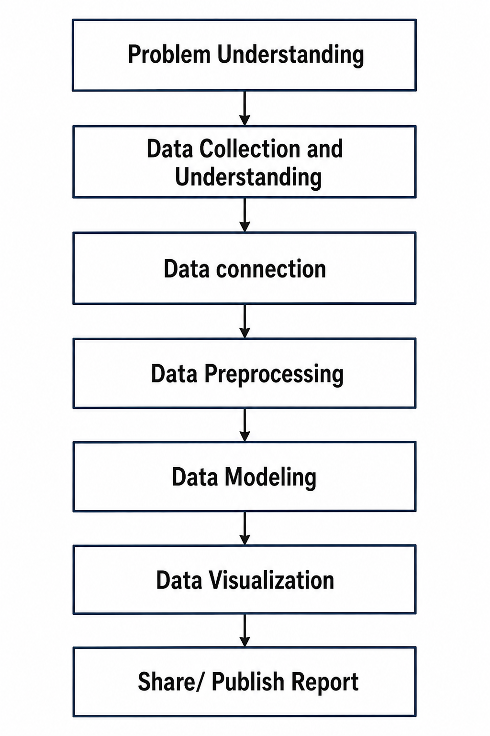
Workflow diagram:

Slide 6


Problem Execution Milestones:
The project was executed through 4 structured milestones to ensure systematic progress and accuracy.
Dataset / Source Used:
Cybersecurity Incident Dataset (CSV) – publicly available dataset used for cybersecurity incident analysis.
Milestone 1 – Data Foundation & Preparation
Dataset collection, preprocessing, cleaning, and data validation.
Date: 09/06/2026
Milestone 2 – Core Dashboard Development
Built the first two interactive Power BI dashboards for cybersecurity analysis.
Date: 16/07/2026
Milestone 3 – Advanced Visualization & Reporting
Created three additional dashboards, generated insights, and completed documentation.
Date: 23/07/2026
Milestone 4 – Advanced Threat Pattern Analysis
Created two additional interactive dashboards for deeper threat pattern analysis and insights.
Date: 13/08/2026

Slide 7
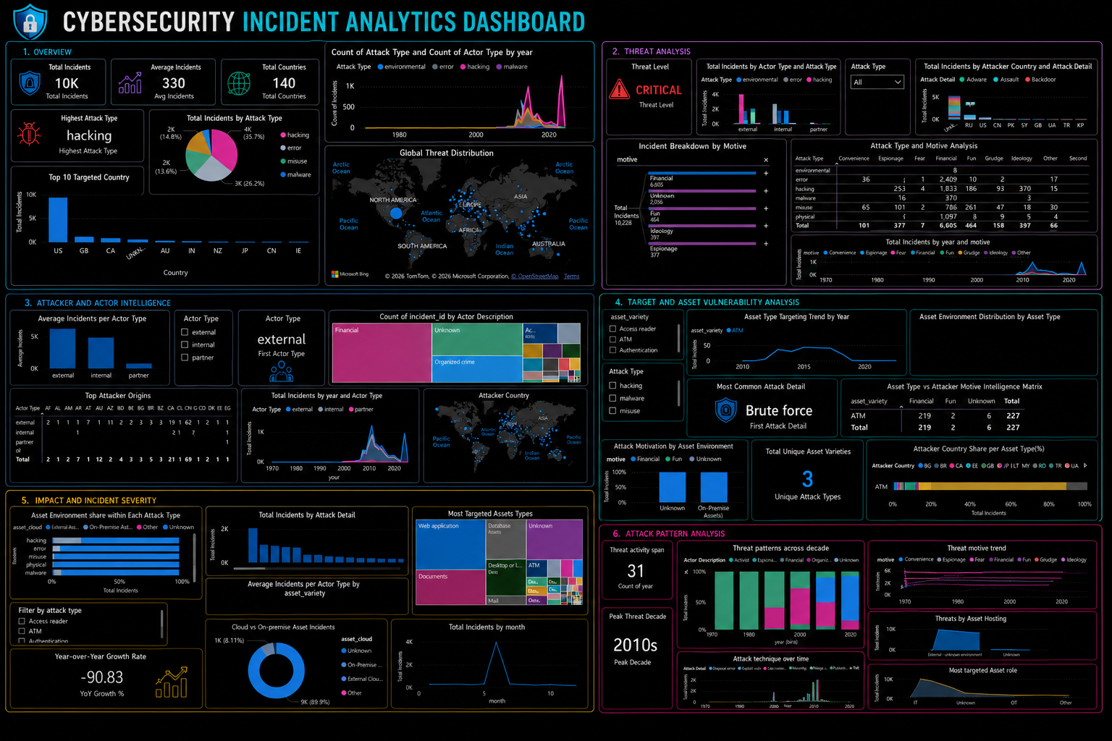

Slide 8
Challenges Faced and Resolutions:
1. Understanding the Cybersecurity Dataset
Challenge: Understanding the large dataset, attributes, and relationships was initially difficult.
Resolution 1: Studied column descriptions and identified attributes relevant to cybersecurity analysis.
2. Data Preprocessing
Challenge: Handling missing values, duplicates, inconsistent entries, and unnecessary columns.
Resolution 2: Used Power Query in Microsoft Power BI for systematic data cleaning and transformation.
3. Selecting Appropriate Visualizations
Challenge: Selecting suitable charts for different cybersecurity information.
Resolution 3: Tested different visualization types and selected the most meaningful visuals for trends and comparisons.

Slide 9
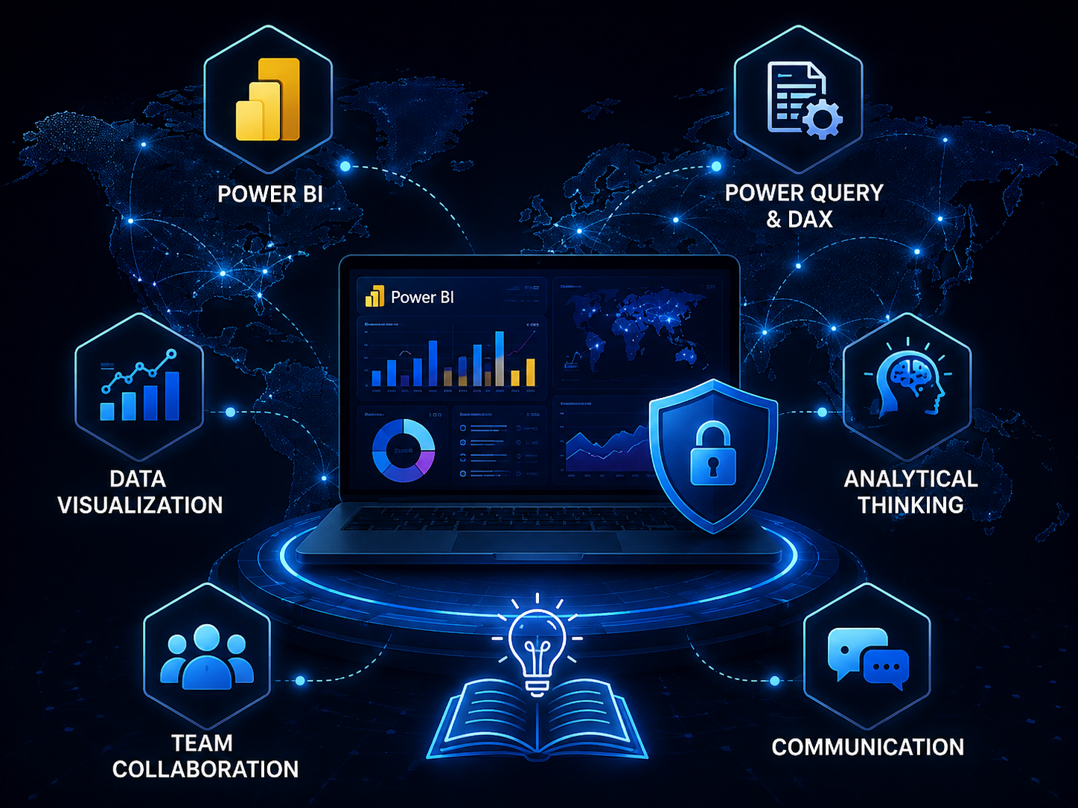
Learning & Skills Acquired:
Technical Skills:
Microsoft Power BI
Power Query
DAX
Data Preprocessing
Interactive Data Visualization
Soft Skills:
Analytical Thinking
Problem Solving
Communication
Documentation
Team Collaboration
Time Management
Overall Learning / Experience:
Gained practical experience in cybersecurity analytics, data visualization, business intelligence, and data-driven decision-making through the development of interactive Power BI dashboards.

Slide 10
Future Enhancements Real-Time Data Integration – Integrate real-time cybersecurity data. Predictive Analytics – Implement machine learning for threat prediction. Automated Alerts – Add automated alerts and advanced dashboard features. Advanced Dashboard Features – Enhance interactive cybersecurity monitoring. Key Insights Hacking emerged as one of the most frequently observed attack methods. External threat actors accounted for a significant number of incidents. The 2010s recorded the highest threat activity, with a significant increase in cyber incidents
Future Enhancements:

Slide 11

Conclusion:
Advanced Threat Incident Analytics and Security Visualization Framework successfully transformed cybersecurity incident data into meaningful interactive insights using Microsoft Power BI.
The project strengthened technical, analytical, and problem-solving skills through data preprocessing, DAX, data modelling, and dashboard development.
It provided practical experience in cybersecurity analytics, business intelligence, and data-driven decision-making.
Overall, the internship complemented academic learning and provided valuable preparation for future opportunities in data analytics, cybersecurity, and business intelligence.

Slide 12
Acknowledgement And References:
I would like to express my heartfelt gratitude to:
Infosys Springboard Team For providing a structured, industry-aligned virtual internship and practical learning platform.
Mentor – Ms. Nityasree For continuous guidance, valuable feedback, and encouragement throughout the project.
Team Members Vennela Pathipaka, Tejasri Lakshmi Maddula, and Twinkle Mohanty for collaboration, accountability, and teamwork.
Other Acknowledgement Microsoft Power BI documentation and community resources, and Kaggle for publicly available datasets.
References
Microsoft Power BI Documentation & Community Resources
Kaggle – Cybersecurity Incident Dataset
Infosys Springboard Virtual Internship 7.0 Learning Resources
Microsoft Power Query Documentation.
Microsoft DAX Documentation

Slide 13


